Slide 1
Developing with Power BI Embedding
Notes:
This module teaches students how to implement Power BI embedding using the Power BI Service API together with the Power BI JavaScript API.

Slide 2

Critical Path Training https://www.CriticalPathTraining.com
PBI365: Power BI Certification Bootcamp – 3 Days
For people who have used Power BI Desktop for 6 months or more
PBD365: Power BI Developer Bootcamp – 4 Days
For professional developers working with the Power BI platform
DDPAF: Deep Dive into Power Apps and Flow – 2 Days
For people just getting started with Power Apps and Flow

Slide 3
Agenda
Power BI Embedding Fundamentals
App Workspaces and Dedicated Capacities
Authentication with Azure Active Directory
Programming with Power BI Service API
Embedding with Power BI JavaScript API
Implementing Embedding in SPFX Web Parts

Slide 4
Agenda
Power BI Embedding Fundamentals
App Workspaces and Dedicated Capacities
Authentication with Azure Active Directory
Programming with Power BI Service API
Working with Embeddable Resources
Embedding with Power BI JavaScript API

Slide 5
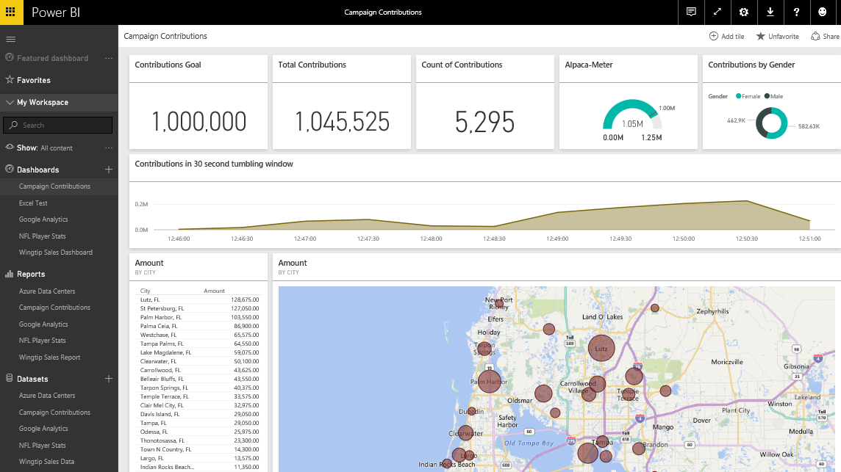
The Power BI Service
Provides cloud-based foundation for Power BI platform
Accessible with browser through https://app.powerbi.com
Accessible through Power BI mobile apps
Accessible to developers through Power BI Service API
Notes:
You can think of the Power BI service as the heart and sole of the Power BI platform. Subscribed users access the Power BI service using any modern browser through its primary URL which is https://app.powerbi.com. Once a user has been authenticated against the common endpoint of https://app.powerbi.com, the users is then connected to the Azure data center which hosts the user’s Power BI workspaces.
Using the browser, a Power BI subscriber can view dashboard and interactive reports. The browser-based experience of the Power BI service also provides support to import datasets and to create reports and dashboards.

Slide 6
The Power BI Service API
The Power BI Service API goes by other names
The Power BI REST API
The Power BI API
Using the Power BI Service API
Accessible by making direct REST calls against service
Accessible by using Assembly DLL that abstracts away REST calls
Assembly DLL is named Microsoft.PowerBI.Api.dll
Assembly DLL part of NuGet package (Microsoft.PowerBI.Api)
Calling service requires authentication with Azure Active Directory
Your App
Power BI Service

Slide 7
Power BI Embedding – The Big Picture
User launches your app using a browser
App authenticates with Azure Active Directory and obtains access token
App uses access token to call to Power BI Service API
App retrieves data for embedded resource and passes it to browser.
Client-side code uses Power BI JavaScript API to create embedded resource
Embedded resource session created between browser and Power BI service
5
Power BI Service
User
iFrame
6
4
4
3
1
Your App
2
Azure AD

Slide 8
First Party Embedding
App authenticates current user with Azure AD
Your code accesses Power BI Service as current user
Embedding requires Azure AD access token for user
User requires Azure AD account and Power BI license
Your code has access to whatever user has access to
Embed URL for Power BI resource
Access Token for current user
User
Power BI Service
iFrame

Slide 9
Third Party Embedding
App authenticates using Master User Account
Your code accesses Power BI Service as master user
Embedding uses embed token instead of access token
Users don’t need AAD accounts and Power BI licenses
Your code has access to whatever master has access to
Embed URL for Power BI resource
Embed Token created with master user account
User
Power BI Service
iFrame

Slide 10
First Party vs Third Party Embedding
What scenarios use first party embedding?
Organizations where users have Power BI licenses
Embedding Power BI reports in SharePoint and Teams
Development should go beyond out-of-box experience
What scenarios use third party embedding?
Scenarios where users don’t have Power BI licenses
Applications which have custom identity providers
Applications which use identity provider other than AAD

Slide 11
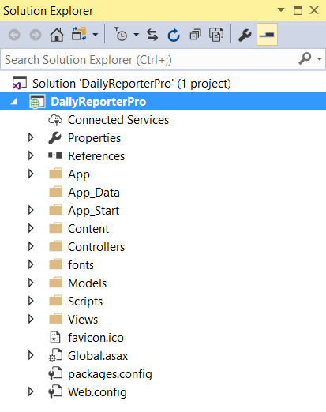
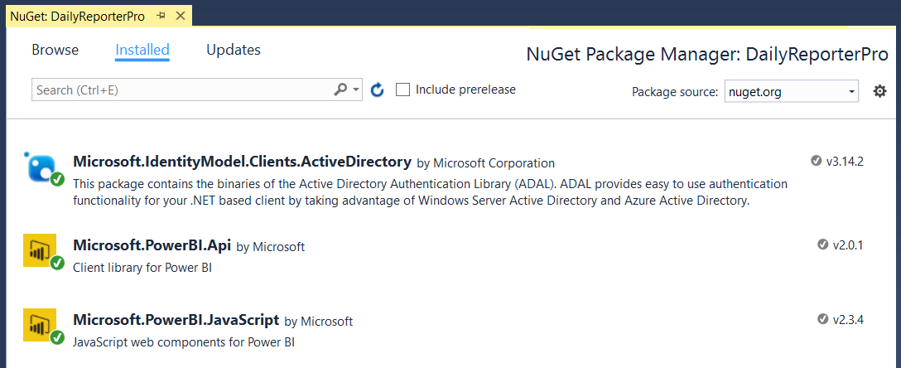
NuGet Packages Required in MVC Project
NuGet Packages used in DailyReporterPro sample app
Azure Active Directory Library (ADAL) for .NET
Power BI Service API
Power BI JavaScript API

Slide 12
The Daily Reporter Pro Sample App

Slide 13
Agenda
Power BI Embedding Fundamentals
App Workspaces and Dedicated Capacities
Authentication with Azure Active Directory
Programming with Power BI Service API
Working with Embeddable Resources
Embedding with Power BI JavaScript API

Slide 14
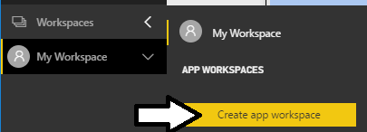
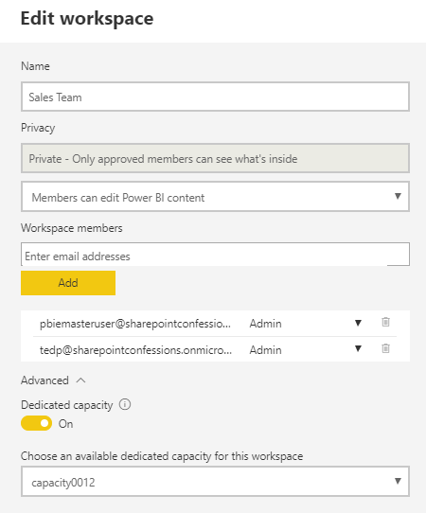
Understanding App Workspaces
App workspaces required for 3rd party embedding
You access working under identity of master user account
Master user account must be configured as app workspace admin
App workspace must be associated with dedicated capacity
Master User Account
Dedicated Capacity

Slide 15
Dedicated Capacities
Power BI workspaces run in two possible environments
Shared capacities
Dedicated capacities
Dedicated capacity required for third party embedding
Customer pays capacity-based fee for processors cores and RAM
No need to pay Microsoft for user licenses
Dedicated capacities come in two flavors
Power BI Premium capacities purchased through Office 365 SKU
Power BI Embedded capacities purchased through Azure SKU

Slide 16
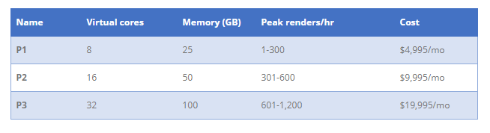
P SKUs (P is for Premium)
All-in version which allows greatest flexibility
Used to provide free users with access to apps and content
Used to support 1st party and 3rd party embedding
The more you pay per month, the more resources you get

Slide 17
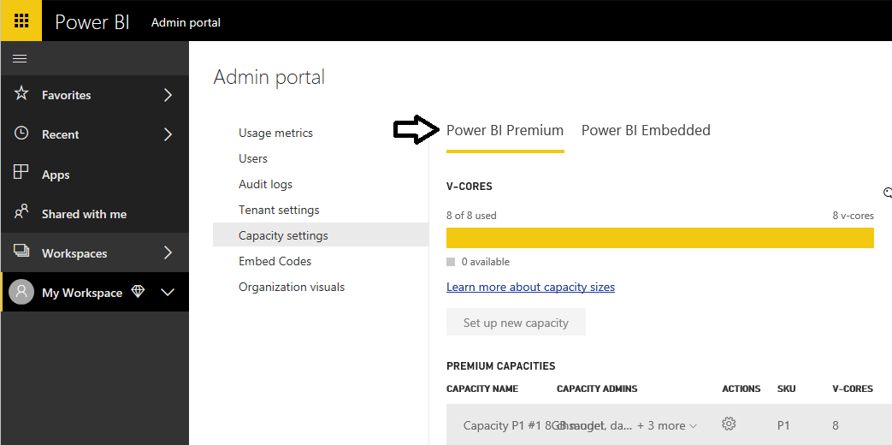
Managing Power BI Premium Capacities

Slide 18
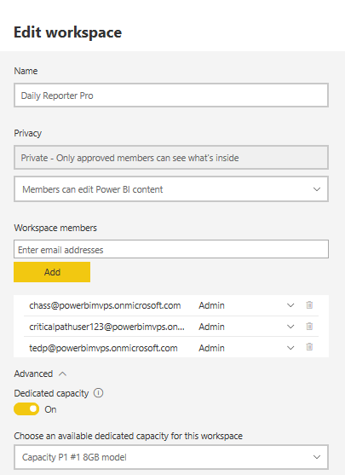
Associating Workspaces with Capacities

Slide 19
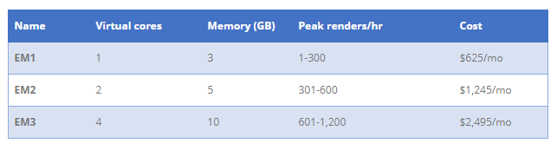
EM SKUs (EM is for Embedded)
SKUs for embedding into SaaS Applications
SaaS applications include SharePoint and Teams
Supports 1st party and 3rd party embedding
Does not provide user with access to PowerBI.com

Slide 20
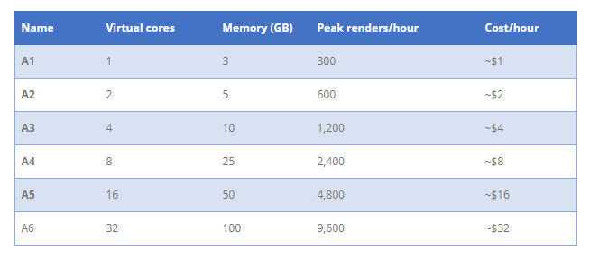
A SKUs (A is for Azure)
A SKU is a Platform-as-a-Service
Used by ISVs as the data visualization layer
Allows for PBI Embedding into Custom Applications
Only supports 3rd party embedding (i.e. App-Owns-Data model)

Slide 21
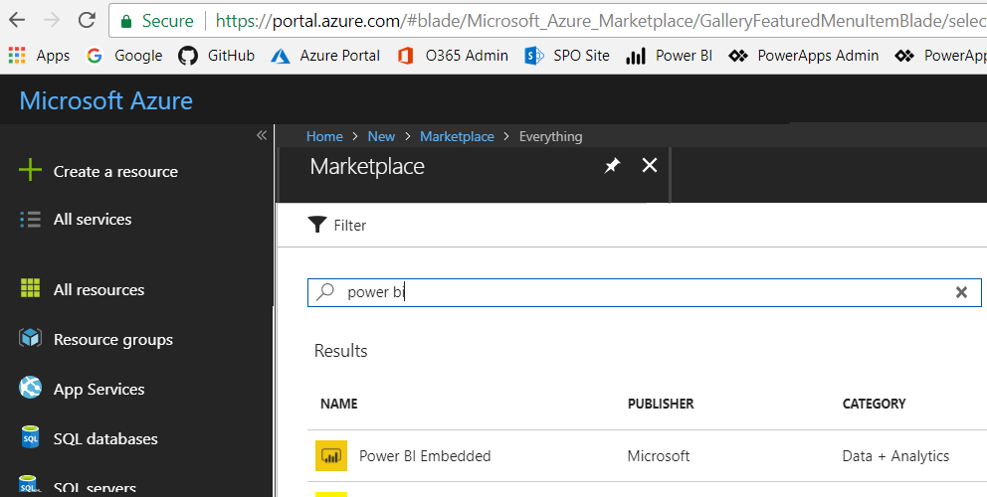
Creating the Power BI Embedded Service
Power BI Embedded in an Azure on-demand service
Can be created manually through the Azure portal
Can be created in automated fashion using PowerShell
Requires an Azure subscription

Slide 22
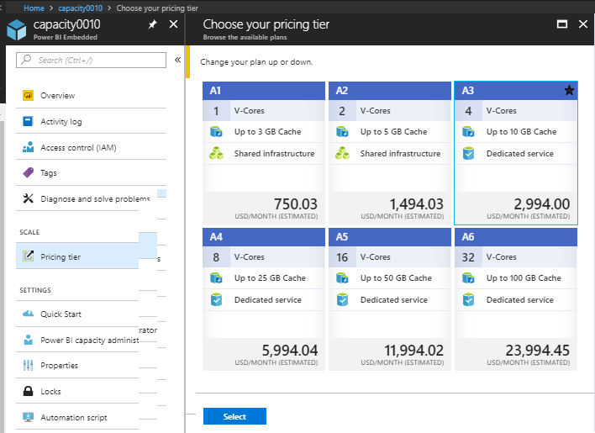
Azure Capacity Pricing Tiers

Slide 23
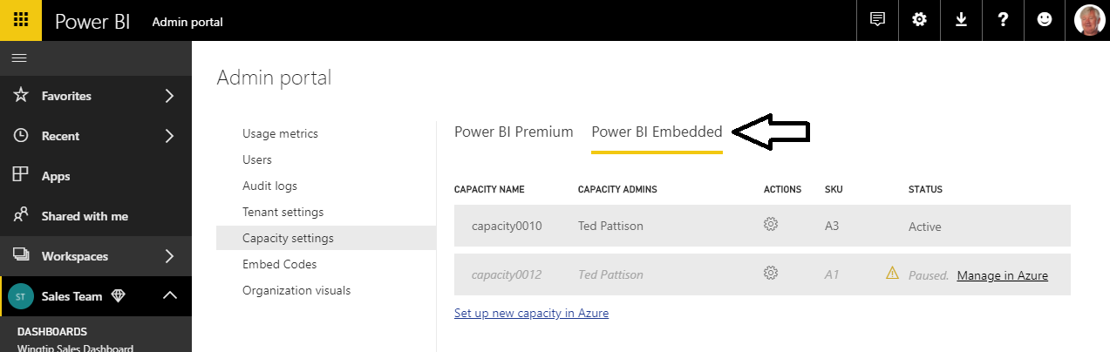
Managing Power BI Embedded Capacities

Slide 24
PBI Capacity SKU Decoder Ring
 | P SKU | EM SKU | A SKU
Purchased through… | Office 365 | Office 365 | Azure
Embed content in custom application | Yes | Yes | Yes
Share content with free PBI users outside PowerBI.com | Yes | Yes | No
Share content with free PBI users inside PowerBI.com | Yes | No | No
Billing | Monthly | Monthly | Hourly
Commitment | Monthly | Monthly/Yearly | None
Turn it off when your not using it | No | No | Yes

Slide 25
Agenda
Power BI Embedding Fundamentals
App Workspaces and Dedicated Capacities
Authentication with Azure Active Directory
Programming with Power BI Service API
Working with Embeddable Resources
Embedding with Power BI JavaScript API

Slide 26
Tenants and Organizational Accounts
Azure AD used to authenticate users and apps
PBI licenses are assigned to Azure AD user accounts
Organization owns a tenant (i.e. directory)
AAD tenant contains user accounts and groups
AAD tenant contains set of registered applications
You must register your application with Azure AD
Requirement of calling to Power BI service API
Applications registered as Web app or Native app
Registered applications are assigned GUID for client ID
Application is configured with permissions

Slide 27
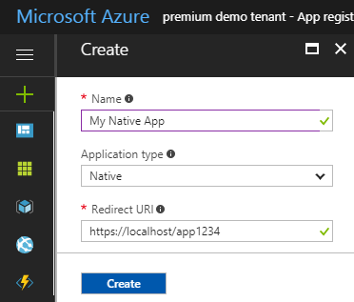
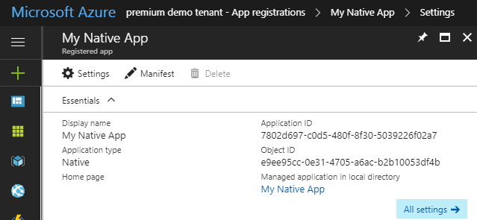
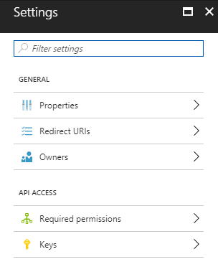
Creating an Azure AD Application

Slide 28
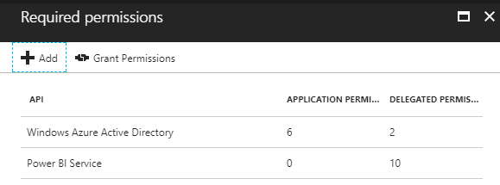
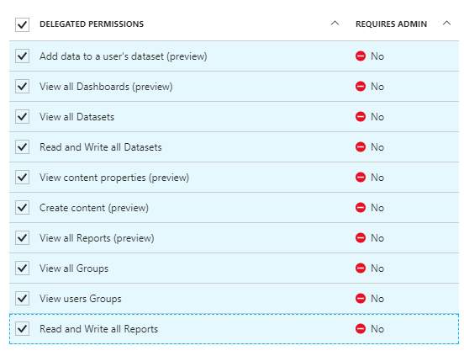
Application Permissions
Applications can be granted permissions to other applications
Application permissions are app-only permissions
Delegated permissions are (app + user) permissions
Delegated permissions requires 1-time consent from user

Slide 29
1st Party Embedding vs 3rd Party Embedding
 | 1st Part Embedding | 3rd Party Embedding
Authentication flow | Authentication Code Grant Flow or Implicit Flow | Direct User Credentials
Identity used to call Power BI | Current User | Master User Account
Access to personal workspace | Yes | No
Access to app workspaces | Yes | Yes
Ability to reach non-licensed users | No | Yes
Supported Power BI Capacity SKUs | P* and EM* SKUs | P*, EM* and A* SKUs

Slide 30
Registering an App with Azure AD

Slide 31
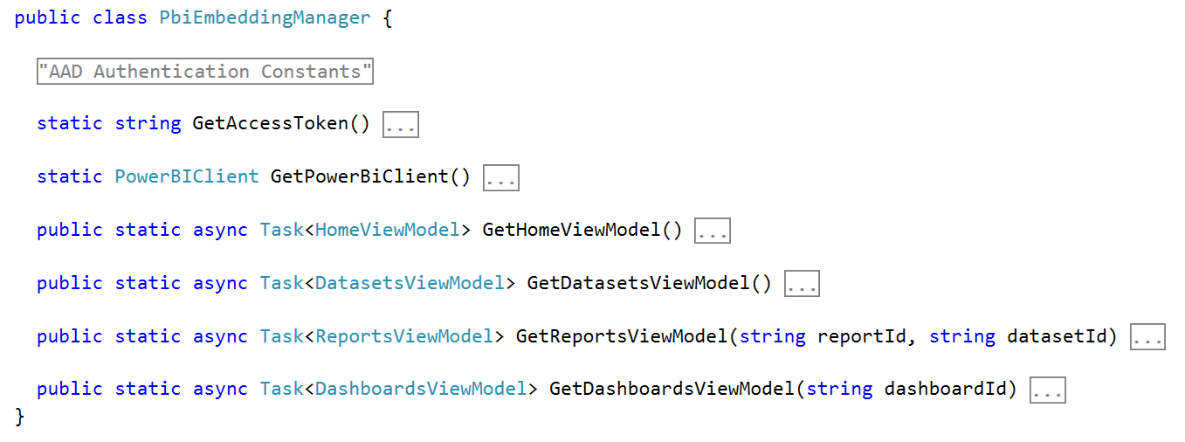
PbiEmbeddingManger Class
PbiEmbeddingManger Class responsibilities
Get access tokens from Azure AD
Retrieve embedding data from Power BI service
Pass embedding data to browser using MVC view models

Slide 32
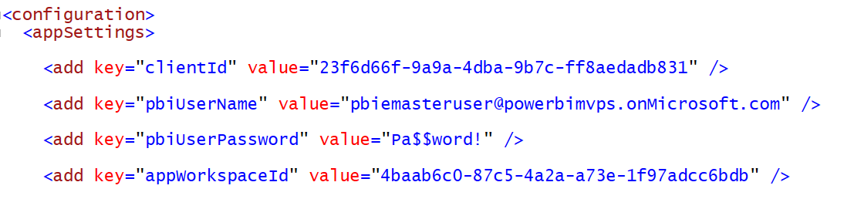
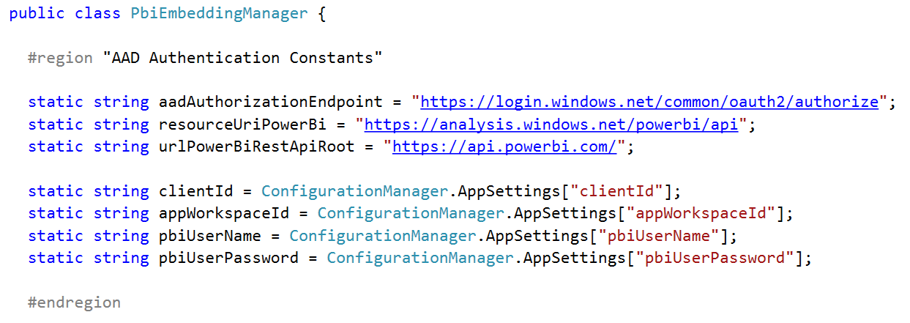
Data Required for AAD Authentication

Slide 33
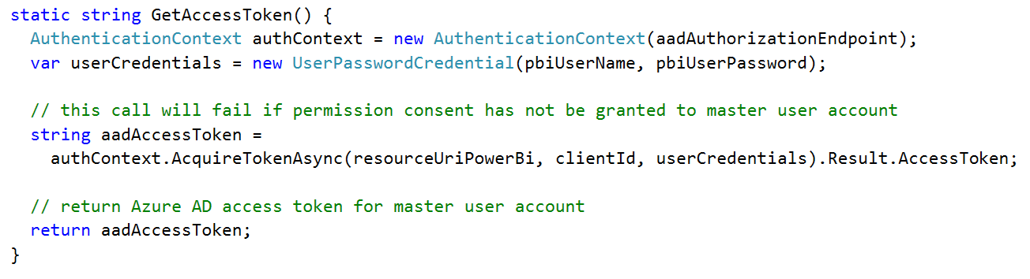
Getting an Access Token for the Master User

Slide 34
Agenda
Power BI Embedding Fundamentals
App Workspaces and Dedicated Capacities
Authentication with Azure Active Directory
Programming with Power BI Service API
Working with Embeddable Resources
Embedding with Power BI JavaScript API

Slide 35
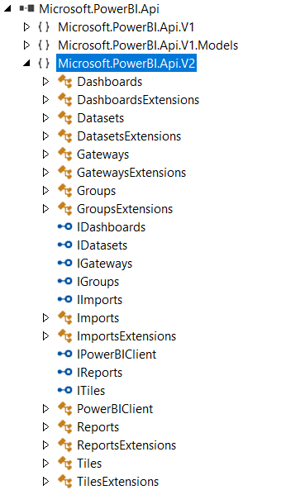
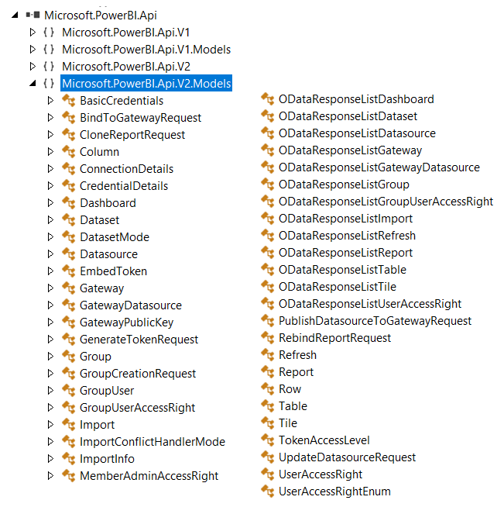
The Power BI Service API

Slide 36
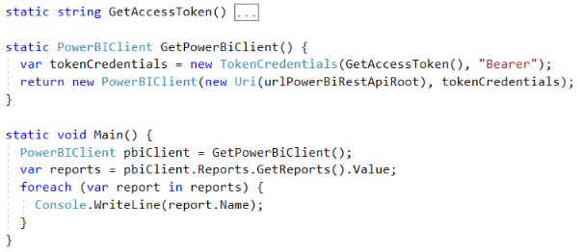
Initializing an Instance of PowerBIClient
PowerBIClient object serves as top-level object
Used to execute calls against Power BI Service
Initialized with function to retrieve AAD access token

Slide 37
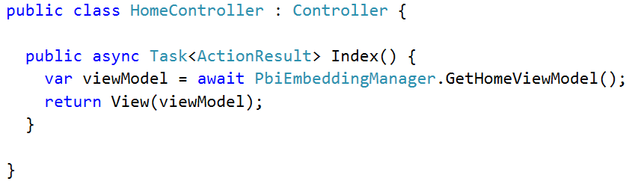
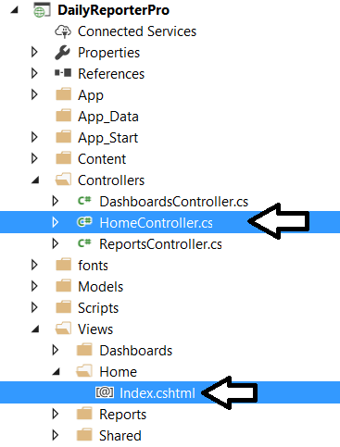
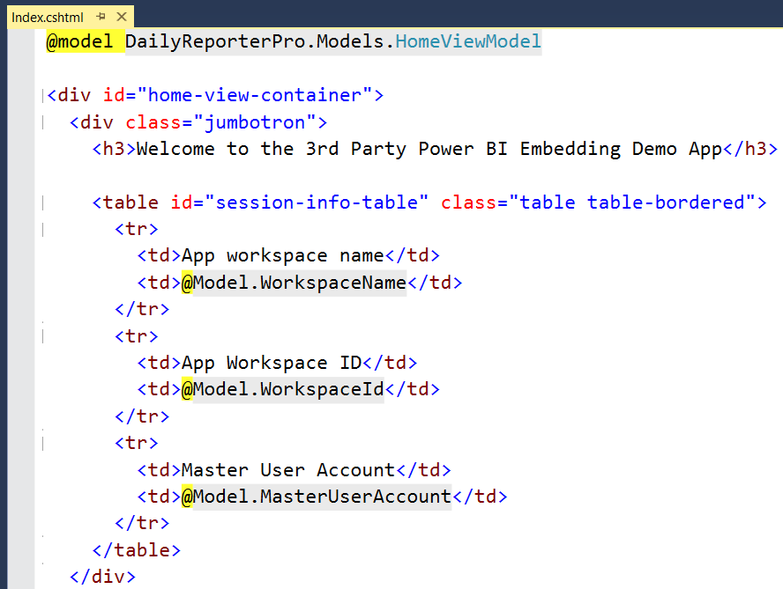
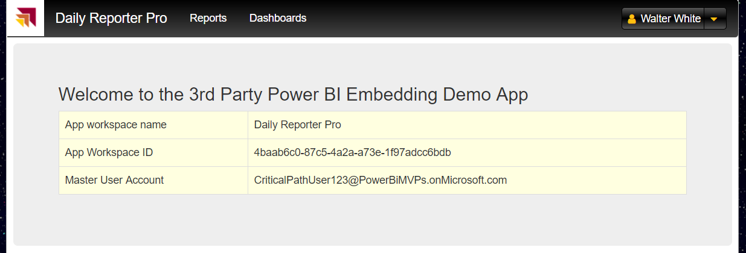
MVC Controllers and Views

Slide 38
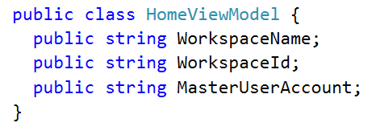
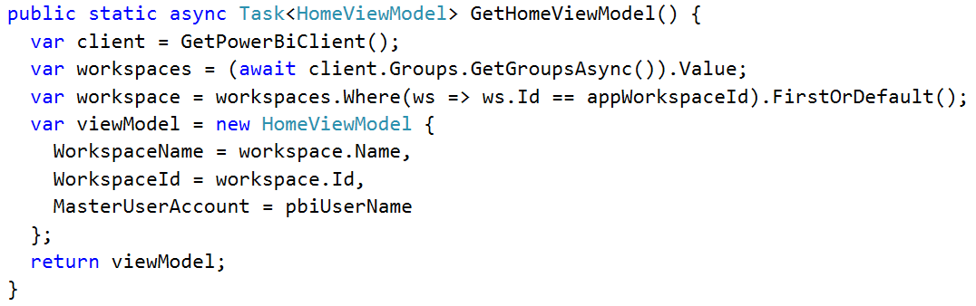
Back to the DailyReporterPro Application
Your App
Power BI Service

Slide 39
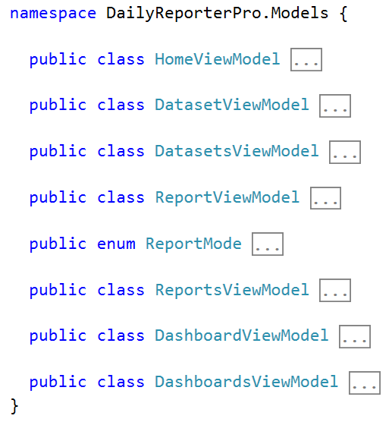
MVC View Models

Slide 40
Agenda
Power BI Embedding Fundamentals
App Workspaces and Dedicated Capacities
Authentication with Azure Active Directory
Programming with Power BI Service API
Working with Embeddable Resources
Embedding with Power BI JavaScript API

Slide 41
Embeddable Resources
Reports
Dashboards
Dashboard Tiles
Q & A Experience
Visual *
* really just a trick you do when embedding a report

Slide 42
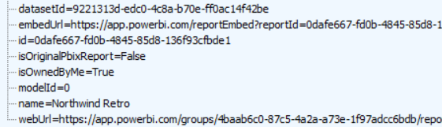
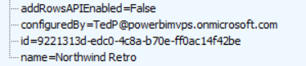
Report and Dataset Info
Embed data required for an existing report
Embed data for dataset required to create new report

Slide 43
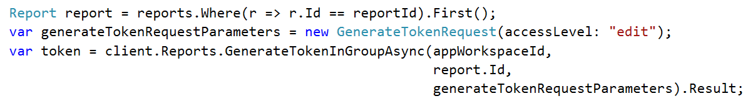
Embed Tokens
You can embed reports using master user AAD token, but…
You might want embed resource using more restricted tokens
You might want stay within the bounds of Power BI licensing terms
Power BI service supports generating embed tokens
Embed token provides restrictions on whether user can view or edit
Each embed token created for one specific resource
Embed token can only be generated inside Power BI Premium capacity
Supports generating tokens using row-level security (RLS)

Slide 44
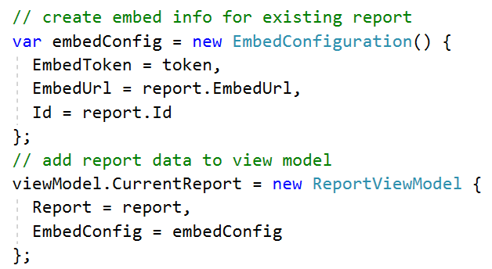
View Model with Embed Data for Report

Slide 45
Agenda
Power BI Embedding Fundamentals
App Workspaces and Dedicated Capacities
Authentication with Azure Active Directory
Programming with Power BI Service API
Working with Embeddable Resources
Embedding with Power BI JavaScript API

Slide 46
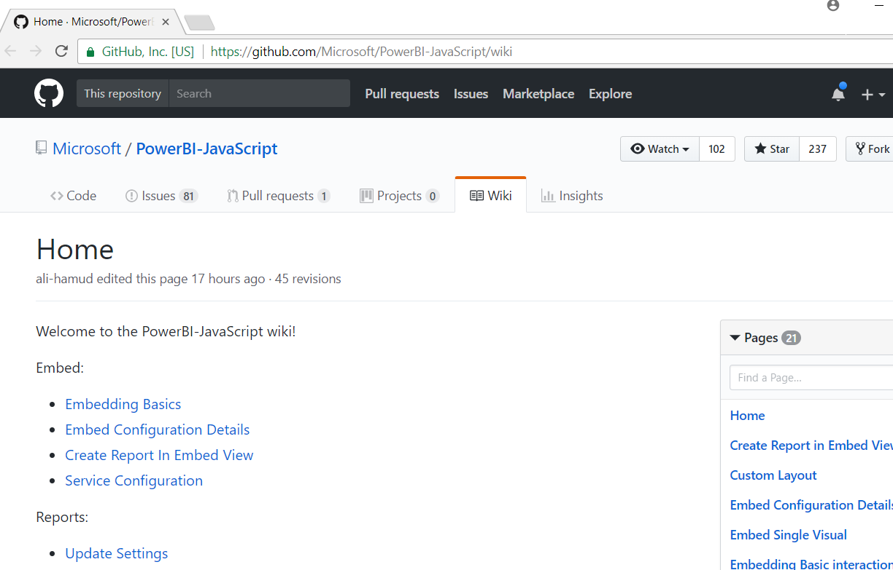
Power BI JavaScript API (PBIJS)
https://github.com/Microsoft/PowerBI-JavaScript/wiki

Slide 47
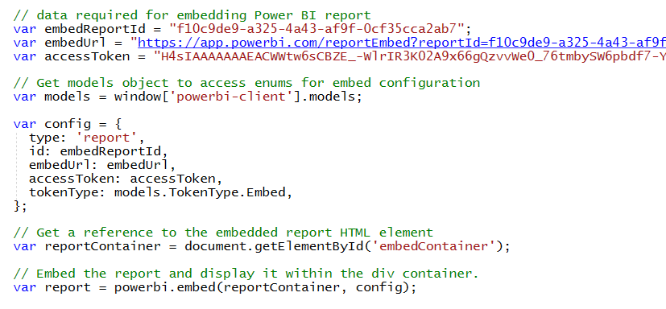
Hello World with Power BI Embedding
PBIJS library provides powerbi as top-level service object
You create configuration and then call powerbi.embed to embed a report
You must pass access token as part of the configuration

Slide 48
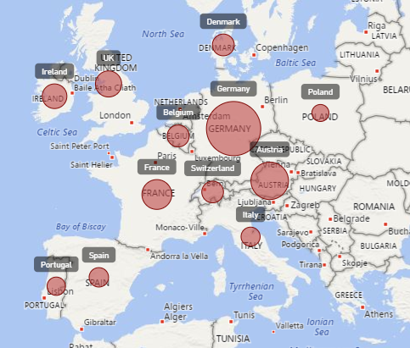
Report Embedding Architecture
Embedding involves creating an iFrame on the page
PBIJS transparently creates iFrame and sets source to Power BI Service
The iFrame and hosting page originate from different DNS domains
Your HTML and CSS
https://app1.mydomain.com
Web Hosting Server
Your
JavaScript
iFrame
Embedding Data
https://wabi-us-east2-redirect.analysis.windows.net/
powerbi.js
Power BI Service

Slide 49
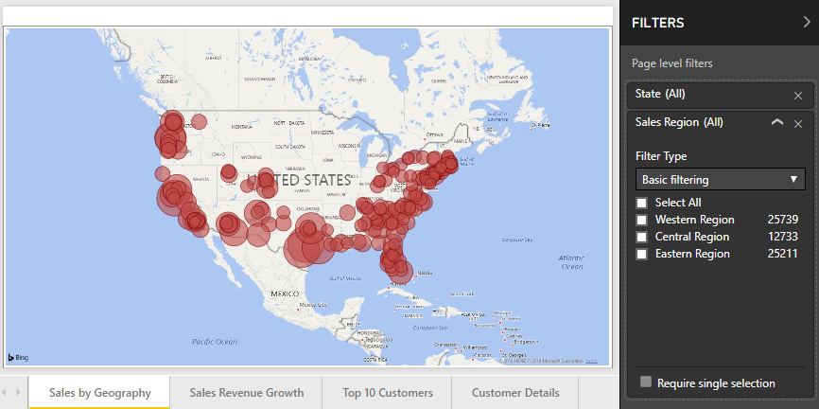
Post Message Communications Flow
4 extra libraries used communicate with report in iFrame
window-post-message-proxy (WPMP)
http-post-message (HPM)
powerbi-router (PBIR)
powerbi-models (PBIM)
iFrame
Your
JavaScript
service
report
HPM
PBIR
WPMP
WPMP
PBIR
HPM

Slide 50
A Promise-based Programming Model
Design of PBIJS simulates HTTP protocol
Creates more intuitive programming model for developers
Programming based on asynchronous requests and promises
Embedded objects programmed using actions and events
Actions
report.fullscreen
report
report.switchMode
report.setFilters
Your
JavaScript
report.getPages
Events
report.loaded
report.pageChanged
report.commandTriggered

Slide 51
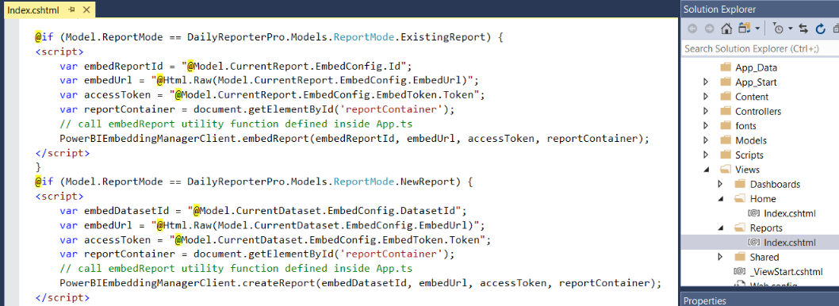
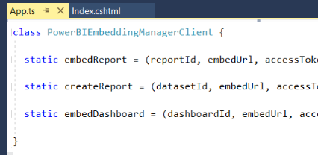
Embedding Data in MVC View

Slide 52
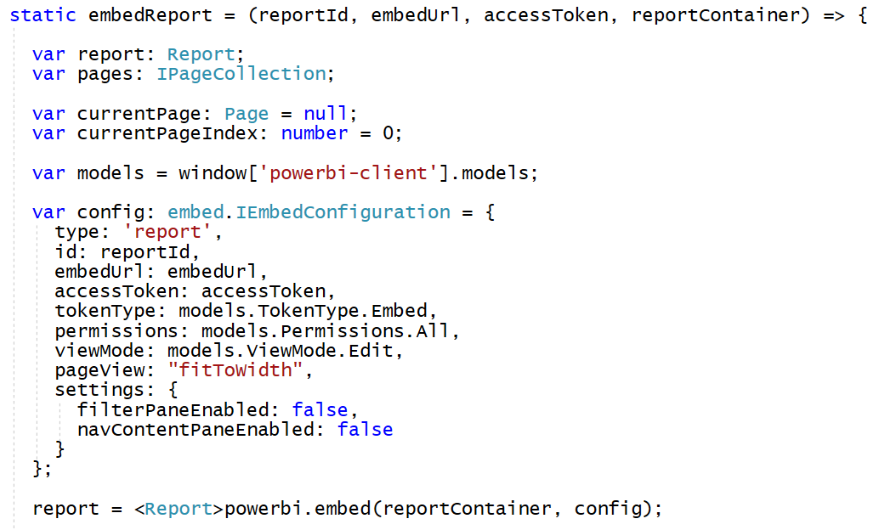
Loading an Embedded Report

Slide 53
Embedded Report Options
Read: Allows view report only.
ReadWrite: Allows view, Edit and Save report.
Copy: Allows Save a copy of a report using Save As.
Create: Allows creating a new report.
All: Allows everything.
View - Opens report in View mode.
Edit - Opens report in Edit mode.
fitToWidth: Fit to width of host HTML element.
oneColumn: Opens in single column.
actualSize: Actual size as designed in report

Slide 54
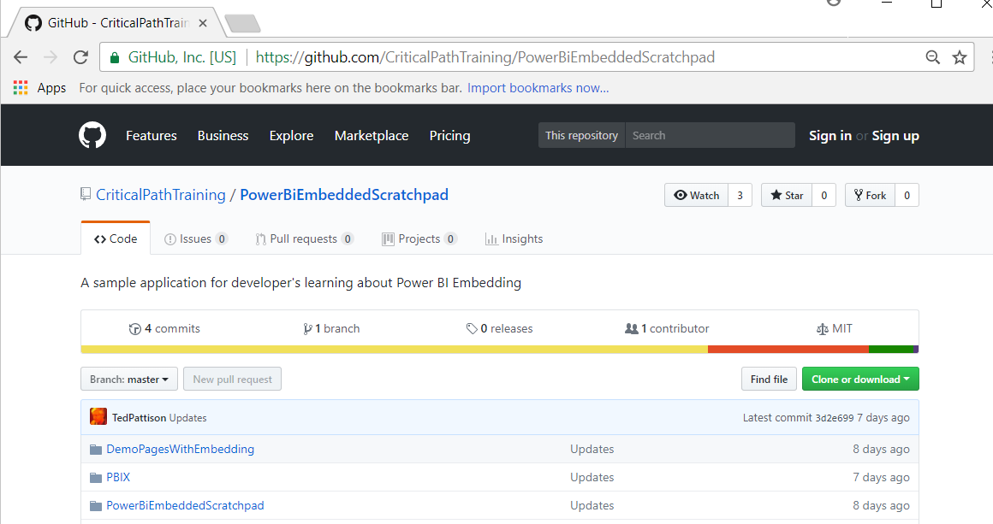
PowerBiEmbeddedScratchpad Sample
https://github.com/CriticalPathTraining/PowerBiEmbeddedScratchpad

Slide 55
The Power BI Embedded Scratchpad App

Slide 56
Summary
Power BI Embedding Fundamentals
App Workspaces and Dedicated Capacities
Authentication with Azure Active Directory
Programming with Power BI Service API
Working with Embeddable Resources
Embedding with Power BI JavaScript API

Slide 57
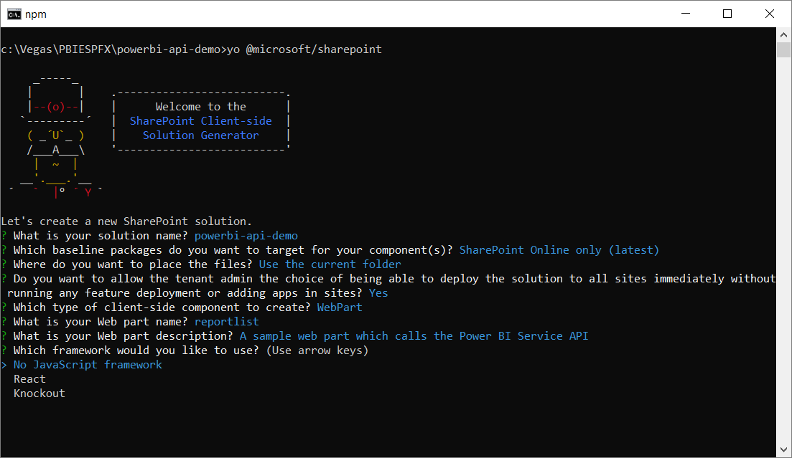
Create a New SPFX Web Part Project

Slide 58
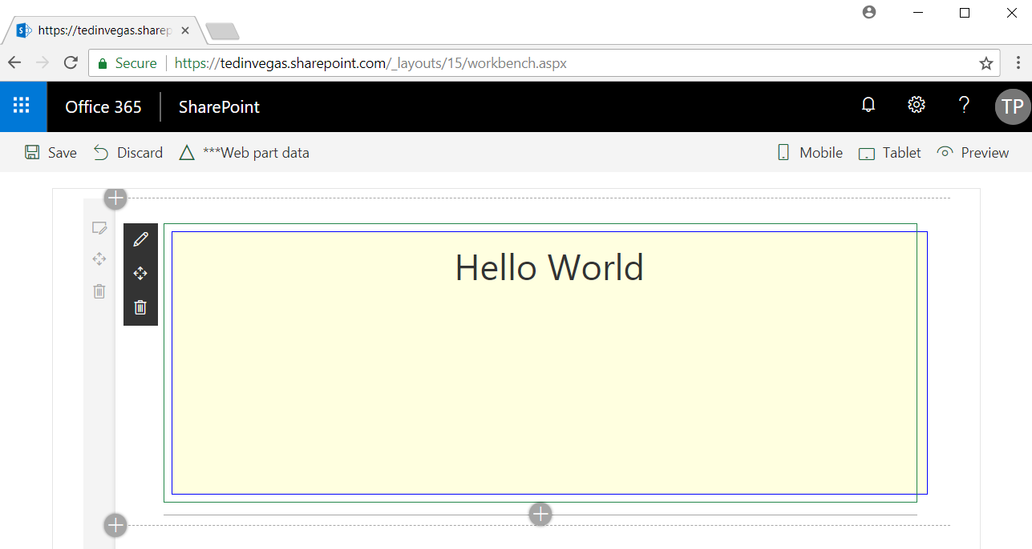
SharePoint Workbench

Slide 59
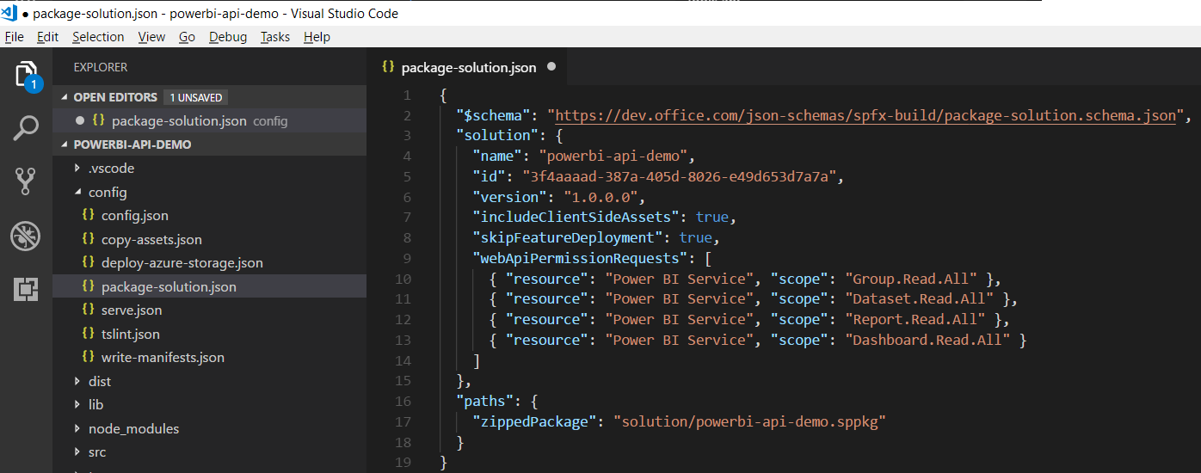
Configuring Web API Permissions

Slide 60
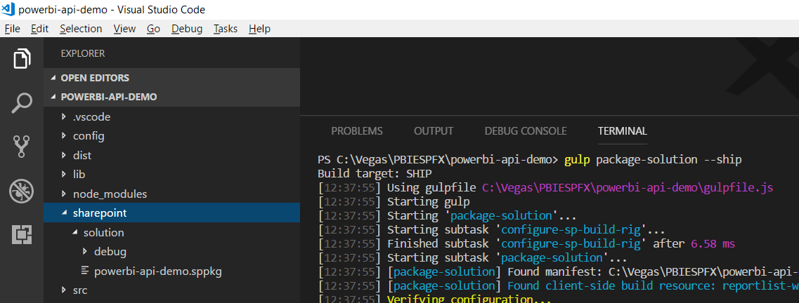
Packaging Your SPFX Solution

Slide 61
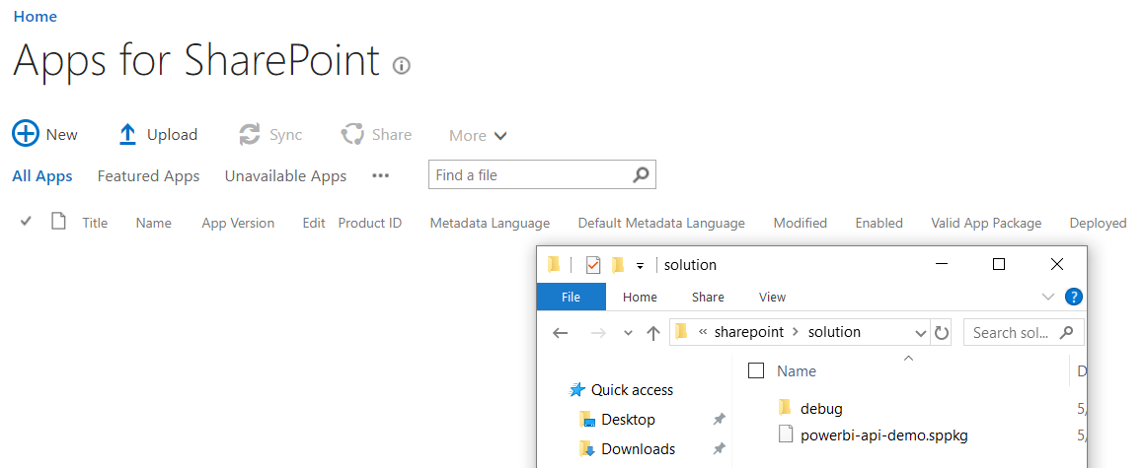
Deploy the Web Part to the App Gallery

Slide 62
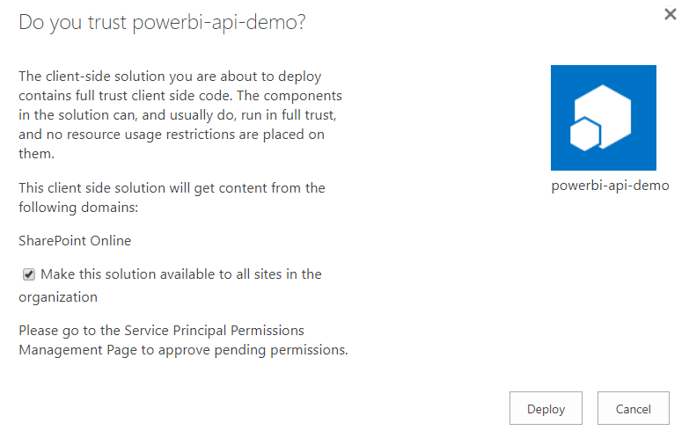
Configuring Trust

Slide 63





Granting Web API Permissions

Slide 64


Calling the Power BI Service API with AadHttpClient

Slide 65



npm install powerbi-client --save

Slide 66


